Slide 1



Big Data Ingestion part 1
#dutchazuremeetup
18:00 Dinner
18:45 Word of Welcome
Pascal Naber
18:55 Introduction to Big Data Ingestion Marco Mansi
19:05 Azure Event Hub
Pascal Naber
19:50 Azure Stream Analytics
Marco Mansi
20:45 Event Hub Processor SDK
Sander Molenkamp
SSID: Xebia-Amsterdam-Guest
PWD: EasyAccess

Slide 2
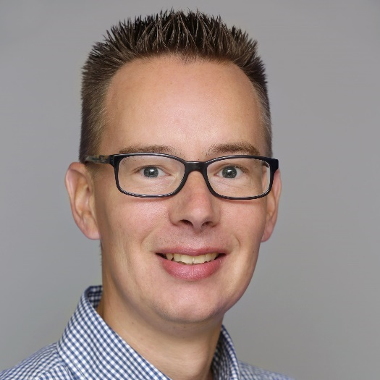
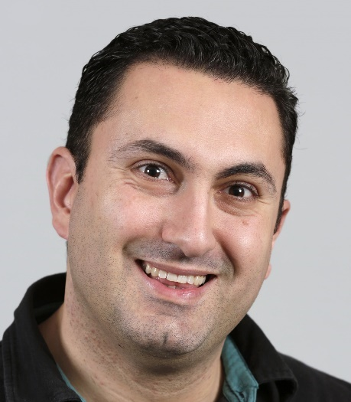
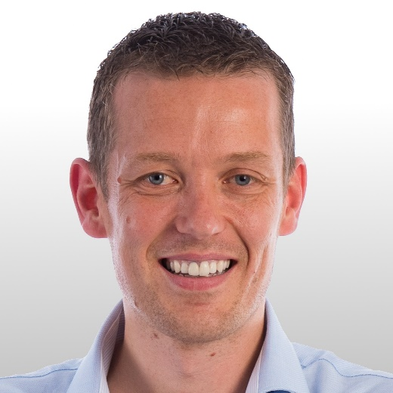



Your Hosts
Welcome
Pascal Naber
Marco Mansi
Sander Molenkamp

Slide 3
Schedule
18:45 | Word of Welcome | Pascal Naber
18:55 | Introduction to Big Data Ingestion | Marco Mansi
19:05 | Azure Event Hub | Pascal Naber
19:20 | Guided Hands-on
19:50 | Azure Stream Analytics | Marco Mansi
20:05 | Coffee Break
20:15 | Guided Hands-on
20:45 | Event Hub Processor | Sander Molenkamp
21:00 | Guided Hands-on

Slide 4

Scheduled meetups
23 February Big Data Ingestion part 2 Data Factory HDInsight, External expert: Alexander Bij
20 April Serverless with Azure Functions

Slide 5

Feedback board
Topics & Speakers next time
Tell us what you think about this meetup

Slide 6

Free Xpirit Magazine
Get your copy of the magazine here:
http://xpirit.com/magazine

Slide 7

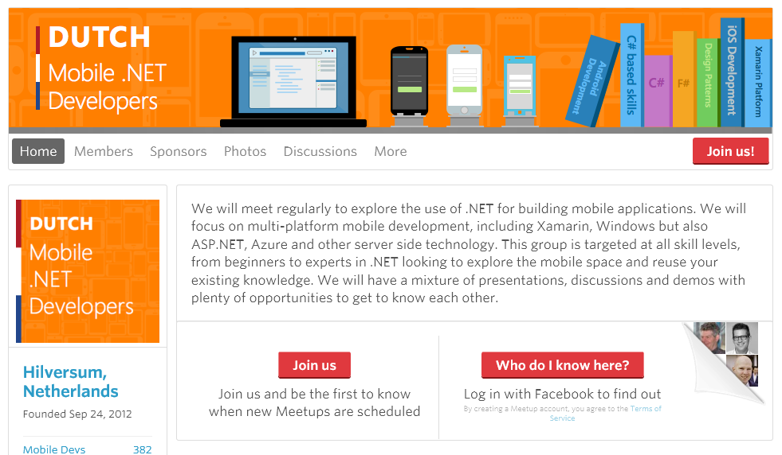
22 feb – Gouda Everything Xamarin & mobile
http://bit.ly/dmobnetdev

Slide 8

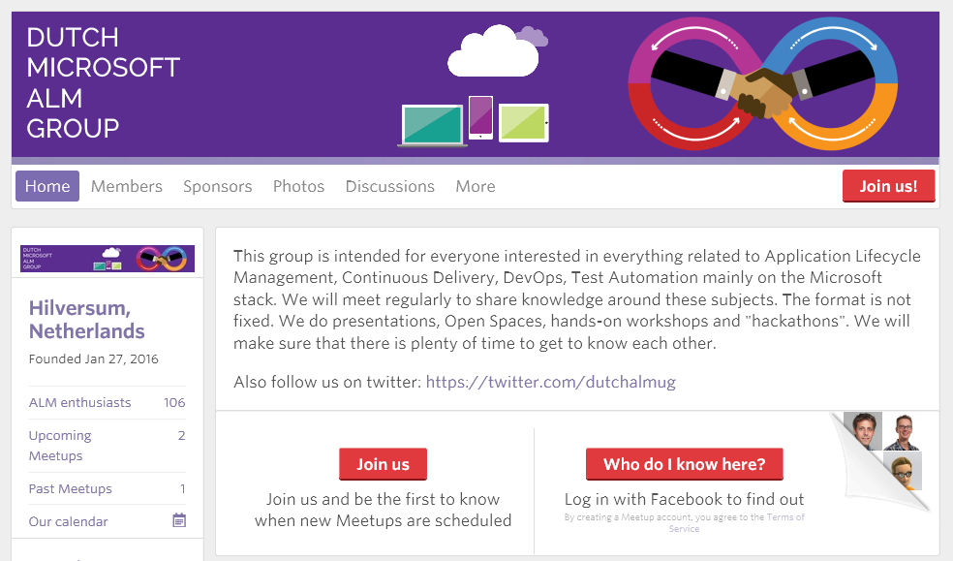
ALM
16 Feb
18 May
21 Sept
7 Dec
http://bit.ly/dmsalmgroup

Slide 9

Get your hands dirty

